Slide 1
Church Financial Recordkeeping
Presented by,
Sapna Patil,
Saboor Siddiquie,
Mrudula Kosaraju,
Kranthi Paladugu.

Slide 2
Contents
Introduction to our project
Client/Customer/User
Requirements
Team organization
Process model
Communication
Project plan
Task list
Uml diagrams
User interface design
Status of project
conclusion

Slide 3
Introduction to our project
It is a financial recordkeeping application.
Our project is to maintain donation records made to a Church.
This is to replace the existing system, with robust features to support the needs of secretary.
This application allows the user to enter the funds and also print reports, monthly or annually.

Slide 4
Client/Customer/User
The Church financial application is used by the church secretary.
Secretary uses the application to keep records of all the donations, and generate reports.
Prof. Cerise Wuthrich is the client, customer and user for our project.

Slide 5
Requirements
Existing system:
The existing system is lacking of shortcut controls.
It has lot of bugs in it.
It doesn’t support to edit the existing records of information of a member.
It is difficult to customize the reports.
It doesn’t allow to modify the things until the user logout and login back.

Slide 6
Requirements
Proposed system:
It allows to add, delete the members at any time.
It allows to add, delete funds of members at any time.
The customized reports can be generated for different period of time.
It is user friendly application.
We are trying to develop a bug free application.

Slide 7
Team organization
The team is utilizing a controlled decentralized structure.
The team leader’s part is to appoint the tasks to members in the team.
Each will perform the tasks assigned to them.
The team gathers every Tuesday and Thursday to discuss about the project.
By the end of every week the assigned tasks will be finished and new tasks are assigned.

Slide 8
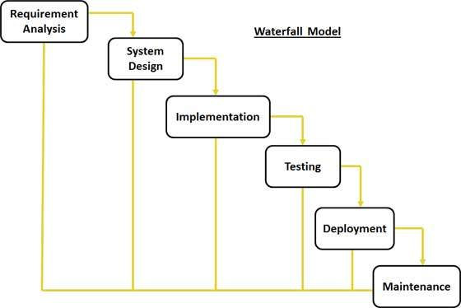
Process model
Water fall model:
It is also referred to as a linear-sequential life cycle model.
It is very simple one to understand and use.
Each phase must be completed fully before the next phase can begin.

Slide 9



Communication
Team is using “WhatsApp” application and emails for communication regarding project.
The team is using Gmail and Github for sharing and storing the files.

Slide 10
Project plan
Proper planning is done for successful completion of the project being development.
Scheduling is done, resources and time period is assigned to each task.
Roles and responsibilities are identified and assigned to the team members.
Plan outlines the different areas of the project.

Slide 11
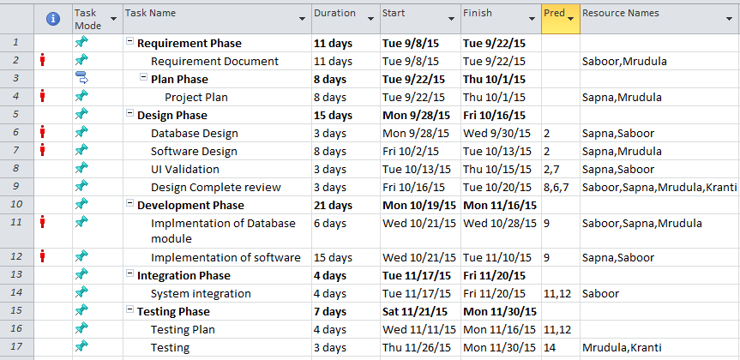
Task list
The following table shows the list of tasks identified in the project.

Slide 12
UML Diagrams
They are partial graphical representation (view) of a model of a system under design, implementation, or already in existence.
UML specification does not preclude mixing of different kinds of diagrams, e.g. to combine structural and behavioral elements to show a state machine nested inside a use case.
UML motivated by the desire to standardize the disparate notational systems and approaches to software design.

Slide 13
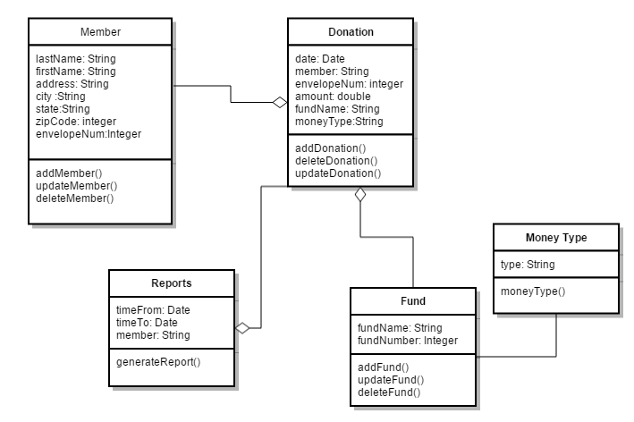
Class Diagram

Slide 14
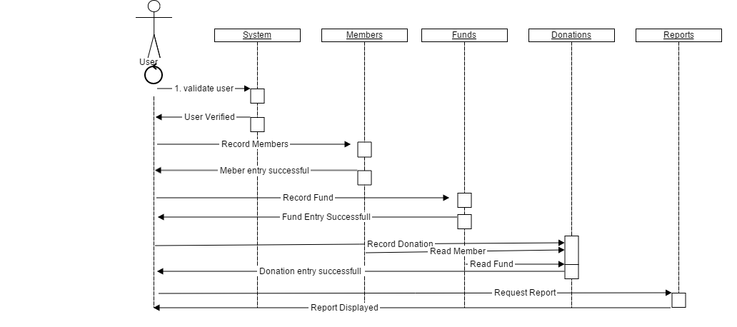
Sequence Diagram

Slide 15
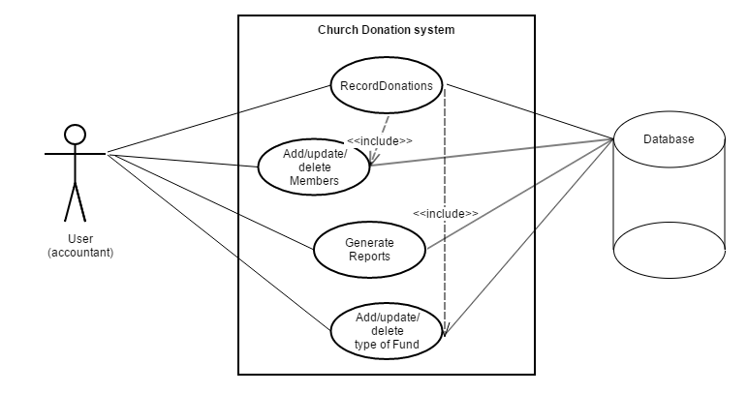
Use case Diagram

Slide 16
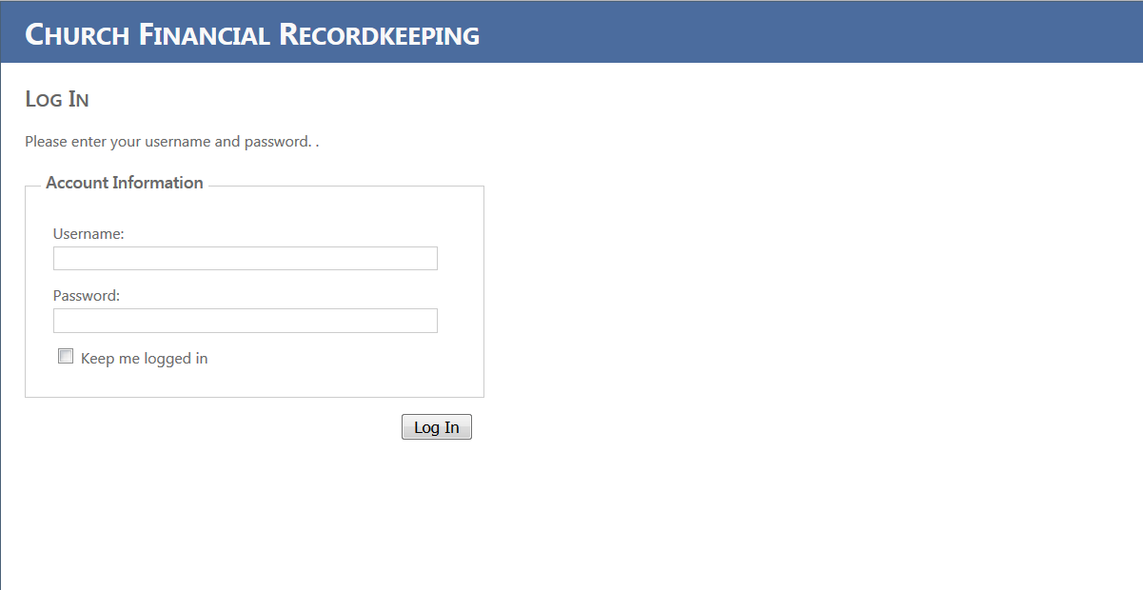
User interface design

Slide 17
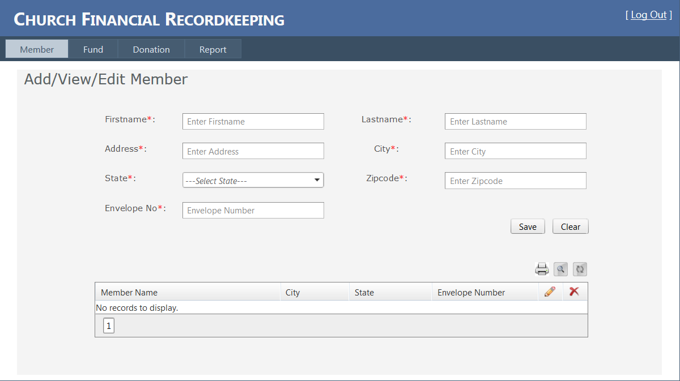

Slide 18
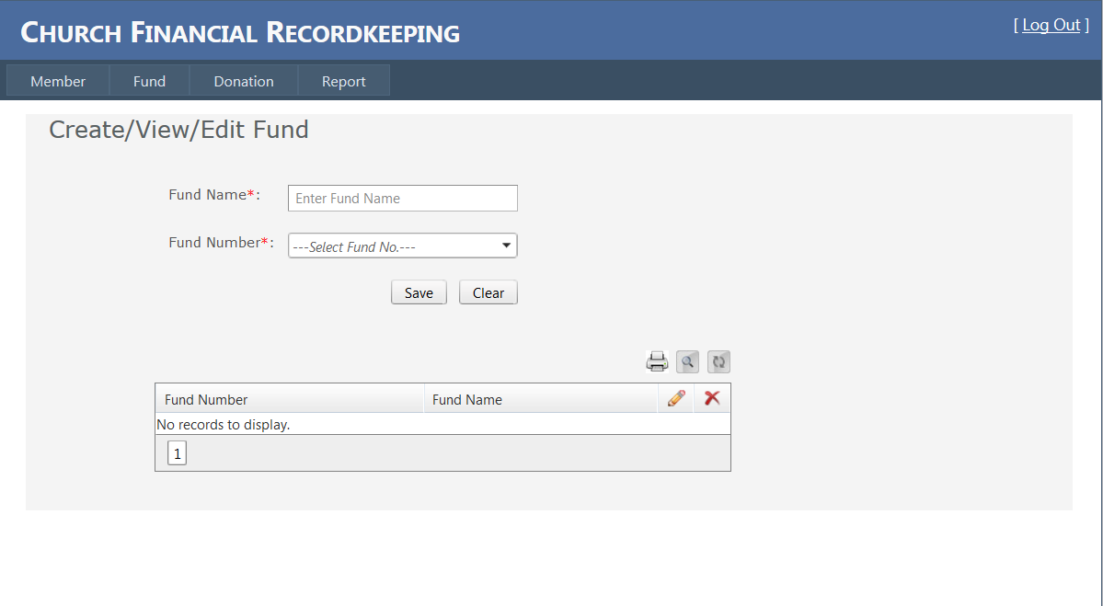

Slide 19
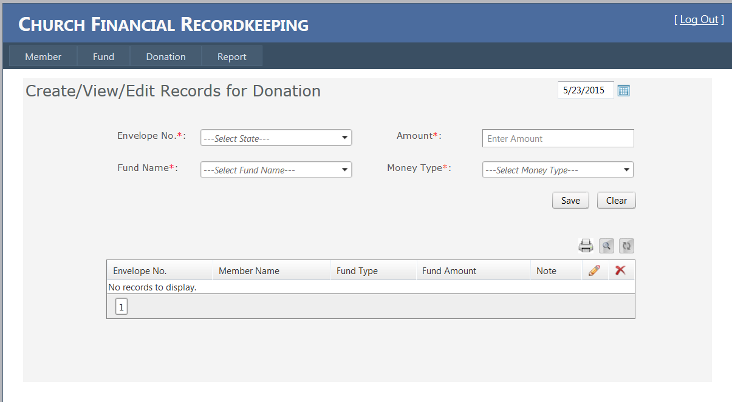

Slide 20
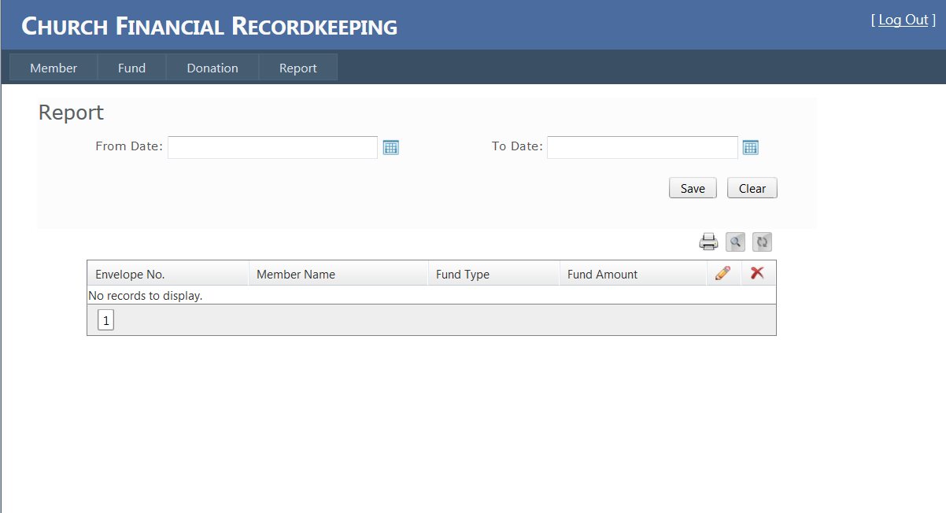

Slide 21
Status of project
Successful completion of the two phases requirement analysis phase and system design.
Project interface designed were made for user feedback.
User manual work in progress.
Planning to start implementation.

Slide 22
Conclusion
Proper planning and designs are made.
Efforts are made by the team members to follow the timeline and complete their task.
Weekly meetings are conducted and issues are discued and solved democratically.
Every task is completed following proper designs and project standards.
Implementation, testing, and user manuals development is planned and team is working towards successful completion of the project.

Slide 23
References
McGraw, R. J. (2015, june 15). FOXMIS. Retrieved october 27, 2015,Google:http://community.mis.temple.edu/mis2101sec711summer2015/
Larman, C., Applying UML and Patterns: Introduction to Object-Oriented Analysis and Design and Iterative Development, 3rdedition (October 2004).
Sommerville, I., Software Engineering 9th edition book, Pearson (March 2004).

Slide 24
Queries…??

Slide 25
Thank you… ☺ ☺ ☺ ☺

